Slide 1
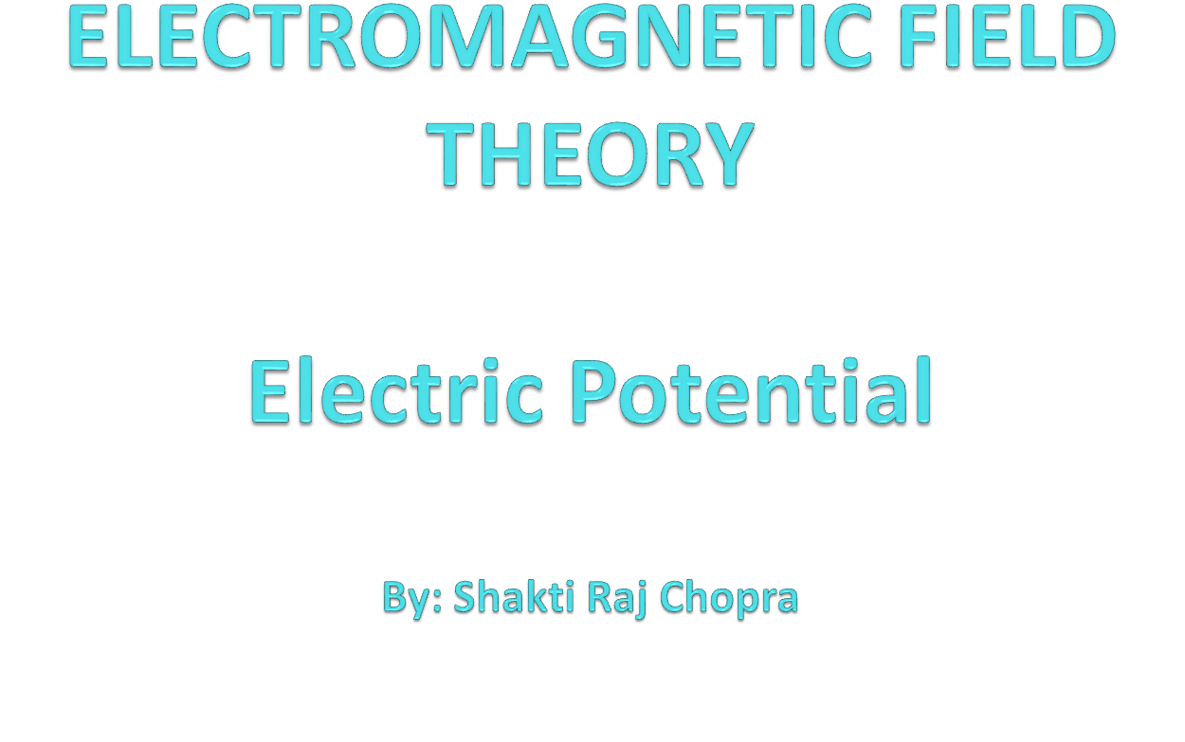

Slide 2
Books
Text Book:
1. PRINCIPLES OF ELECTROMAGNETICS
By - MATTHEW N.O. SADIKU, 4th 2009 OXFORD UNIVERSITY
PRESS, INDIA
Reference Book:
1. ELECTROMAGNETIC WAVES AND RADIATING SYSTEMS
By - EDWARD C. JORDAN 5th PRENTICE HALL

Slide 3
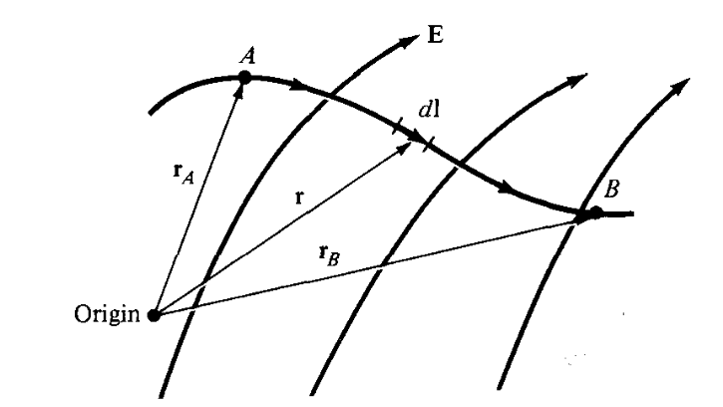

Electric Potential
Suppose we wish to move a point charge Q from point A to point B in an electric field E as shown in Figure. From Coulomb's law, the force on Q is:
F = QE so that the work done in displacing the charge by dl is:

Slide 4
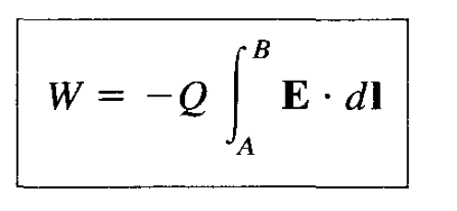
The negative sign indicates that the work is being done by an external agent.
Thus the total work done, or the potential energy required, in moving Q from A to B is
Dividing W by Q in eq. gives the potential energy per unit charge. This quantity, denoted by VAB, is known as the potential difference between points A and B. Thus

Slide 5
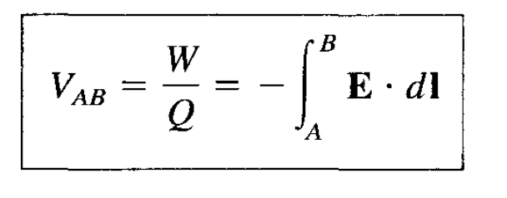
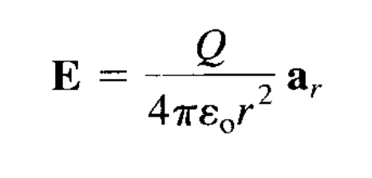
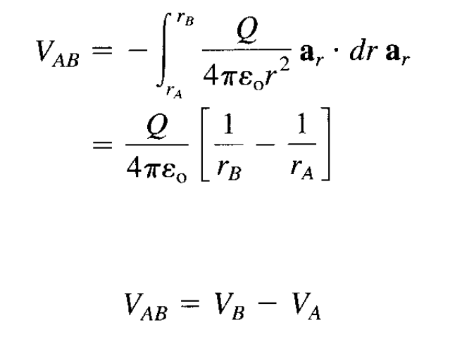
E field in Figure is due to a point charge Q located at the origin, then

Slide 6
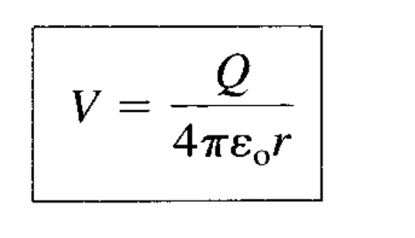
where V_{B} and V_{A} are the potentials (or absolute potentials) at B and A, respectively
Thus the potential difference V_{AB} may be regarded as the potential at B with reference to A.
we assume the potential at infinity is zero.
Thus if V_{A} = 0 as r_{A}—» °° in eq., the potential
at any point (r_{B} —> r) due to a point charge Q located at the origin is

Slide 7
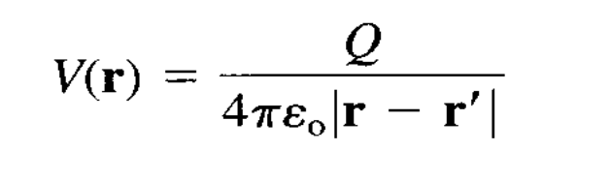
If the point charge Q in eq. is not located at the origin but at a point whose position vector is r', the potential V(x, y, z) or simply V(r) at r becomes
We have considered the electric potential due to a point charge.
The superposition principle, which we applied to electric fields, applies to potentials. For n point charges Q1, Q2,. • • ,Qn located at points with position vectors , r2,. . ., rn, the potential at r is

Slide 8
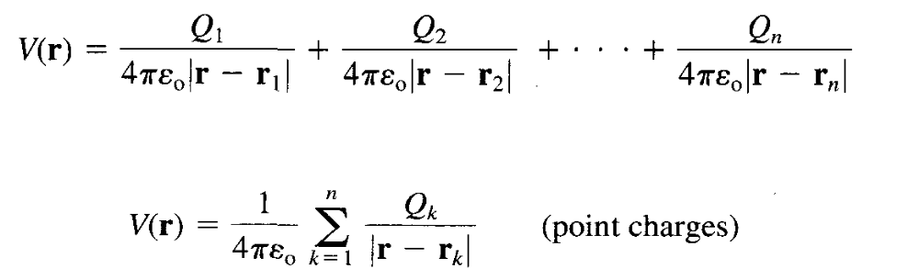

Slide 9
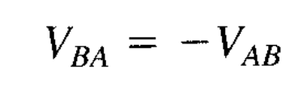
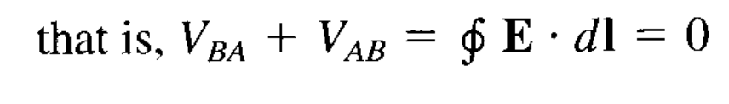
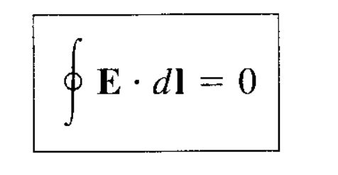
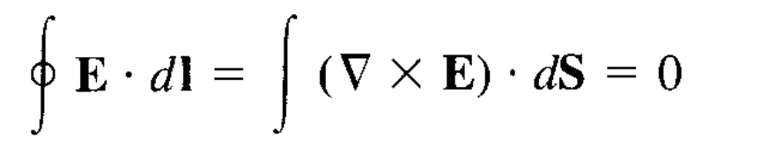
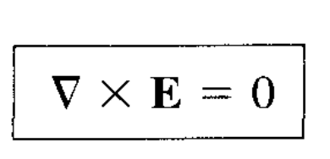
RELATIONSHIP BETWEEN E AND V—
MAXWELL'S EQUATION-2
As shown in the previous section, the potential difference between points A and B is independent
of the path taken. Hence
Applying Stokes's theorem

Slide 10

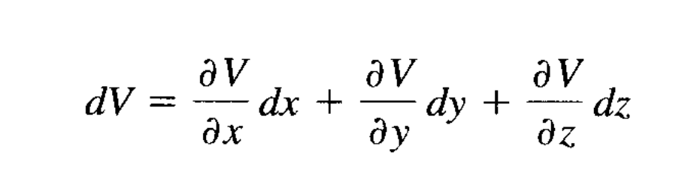
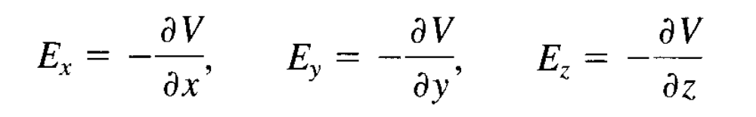
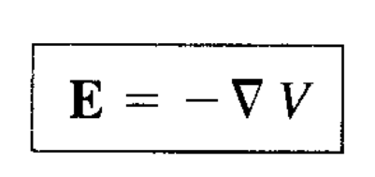
Comparing the two expressions for dV, we obtain

Slide 11


